Slide 1

Probabilistic Discriminative Models

Slide 2
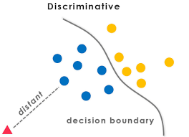
Introduction
What are discriminative models?
Why use probabilistic versions?
Examples: Logistic Regression, Conditional Random Fields

Slide 3
Classification Paradigm
Difference between:
Generative: P(x,y)P(x, y)P(x,y) → use Bayes rule
Discriminative: P(y∣x)P(y|x)P(y∣x) directly
Diagram: Generative vs Discriminative model flow
Probabilistic vs Deterministic Models
Deterministic: Hard decisions (e.g., perceptron)
Probabilistic: Models uncertainty → outputs probabilities
Diagram: Probabilistic output (soft decision) vs deterministic

Slide 4
Why Discriminative Models?
Focus directly on prediction
Often better accuracy
Simpler models (no need to model xxx)
Bayes’ Theorem Refresher
P(y∣x)=P(x∣y)P(y)P(x)P(y|x)
Generative: model P(x∣y),(P(y)
Discriminative: model P(y∣x)

Slide 5
Key Properties
Direct conditional probability estimation
Often convex optimization
Supports probabilistic outputs (soft classification)
Logistic Regression
Simplest probabilistic discriminative model
P(y=1∣x)=σ(wTx)P(y=1|x)
Sigmoid function
Convex optimization

Slide 6
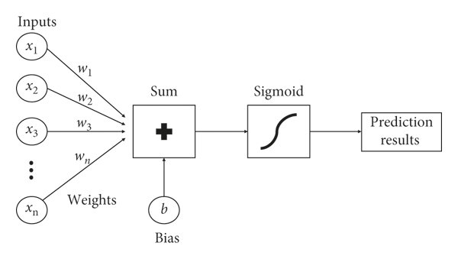
Logistic Regression – Diagram
Diagram: Linear decision boundary and sigmoid curve
Show class probabilities on the sigmoid curve

Slide 7
Maximum Likelihood Estimation (MLE)
MLE maximizes likelihood of observed labels:
L(w)=∏iP(yi∣xi;w)
Use log-likelihood for numerical stability
Regularization in Logistic Regression
L2 (Ridge), L1 (Lasso)
Prevents overfitting
Bayesian interpretation of priors

Slide 8
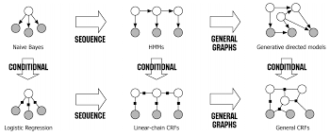
Conditional Random Fields (CRFs)
Structured output: sequences, graphs
Used in NLP (e.g., POS tagging)
P(y∣x)=1Z(x)exp⁡(∑iϕi(x,y))P(y|x)
CRFs – Diagram
Diagram: Chain structure of linear-chain CRF
Explain: nodes = labels, edges = dependencies

Slide 9
Comparison Table
 | Probabilistic | Structure | Output | Application
Logistic Regression | Yes | Flat | Binary | Classification
CRFs | Yes | Sequence | Structured | NLP
SVM | No | Flat | Hard margin | Classification

Slide 10
Limitations
No data generation
May require more labeled data
Difficult for semi-supervised learning
Applications
Spam detection
Speech recognition
Named Entity Recognition (NER)
Image classification

Slide 11
Real-World Example
Use case: Email spam classifier using logistic regression
Input features: frequency of spam words
Output: P(spam∣x)
Summary
Probabilistic discriminative models learn P(y∣x)P(y|x)P(y∣x)
Examples: Logistic regression, CRFs
Widely used due to flexibility and performance

